Slide 1
GIS Internet Services and SDI Technologies

Slide 2
GIS Internet Services and SDI Technologies
System Architecture
Available Services
Technologies that support internet GIS services
Commercial tools for internet GIS

Slide 3
Elemets of SDI
The developers and users of SDIs deal with all four elements:
SDI
GIS
information infrastructure (II)
information and communication technologies (ICT)

Slide 4
Elemets of SDI
An information infrastructure is defined by (Hanseth, 2002) as “a shared, evolving, open, standardized, and heterogeneous installed base” and by (Pironti, 2006) as all of the people, processes, procedures, tools, facilities, and technology which supports the creation, use, transport, storage, and destruction of information.
Information and communications technology (ICT) is an extensional term for information technology (IT) that stresses the role of unified communications and the integration of telecommunications (telephone lines and wireless signals) and computers, as well as necessary enterprise software, middleware, storage and audiovisual, that enable users to access, store, transmit, understand and manipulate information.

Slide 5
Internet and World Wide Web
Internet
A massive network of networks; a networking infrastructure. It connects millions of computers together globally, forming a network in which any computer can communicate with any other computer as long as they are both connected to the Internet
World Wide Web
The World Wide Web (abbreviated as WWW or W3 and commonly known as the Web) is a system of interlinked hypertext documents accessed via the Internet.
With a web browser, one can view web pages that may contain text, images, videos, and other multimedia and navigate between them via hyperlinks.

Slide 6
Internet vs World Wide Web
Internet vs World Wide Web
Many people use the terms Internet and World Wide Web interchangeably, but in fact the two terms are not synonymous. The Internet and the Web are two separate but related things.
Web Mapping
Web mapping is the process of designing, implementing, generating and delivering maps on the World Wide Web.

Slide 7
Web GIS
Web GIS
Web GIS is similar to web mapping but with an emphasis on analysis, processing of project specific geodata and exploratory aspects
Often the terms web GIS and web mapping are used synonymously, even if they don't mean exactly the same
GIS Web Service
GIS resources packaged for distribution on the web

Slide 8
Web GIS
A system to deploy and disseminate spatial data and associated attributes using the Internet
It is an integration of GIS, WWW and Internet Technologies
Access information/data without using desktop GIS software
To make spatial information available for millions of people
Hence, it is very useful way of disseminating spatial information to general public.

Slide 9
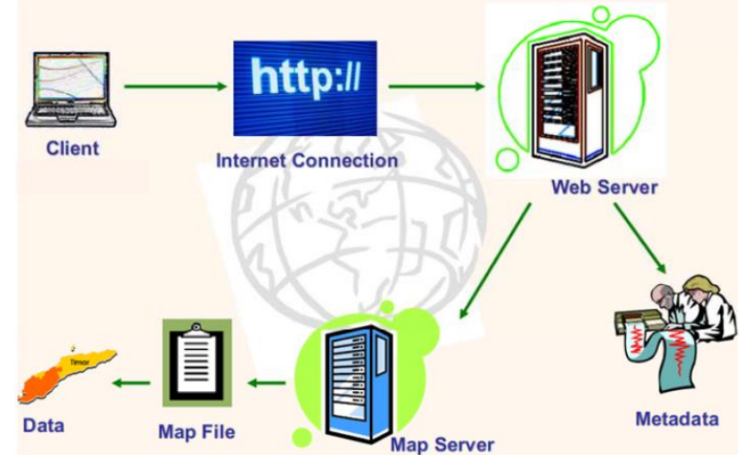
Web GIS Components

Slide 10
Web GIS Components
Client:
Internet Browser such as Chrome, Mozilla Firefox etc
Internet Connection:
Performance of a web mapping site largely depends on the – Higher the bandwidth better the performance
Web server
Handle the requests from Web Browser (user) and Return the web page – Apache, IIS
Map Server
Generate the web products
Meta Data
data about the data – Including Server URL, Owner etc

Slide 11
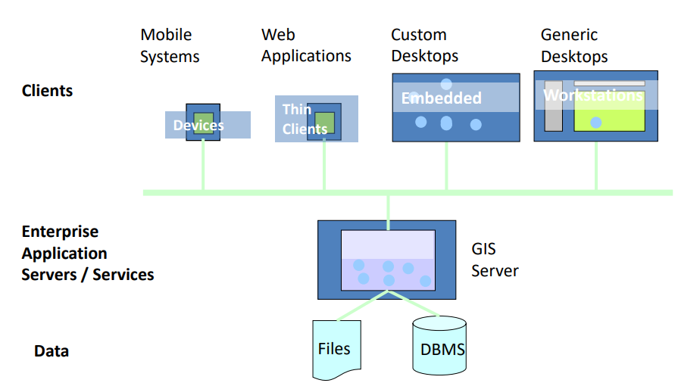
Web GIS Architecture

Slide 12
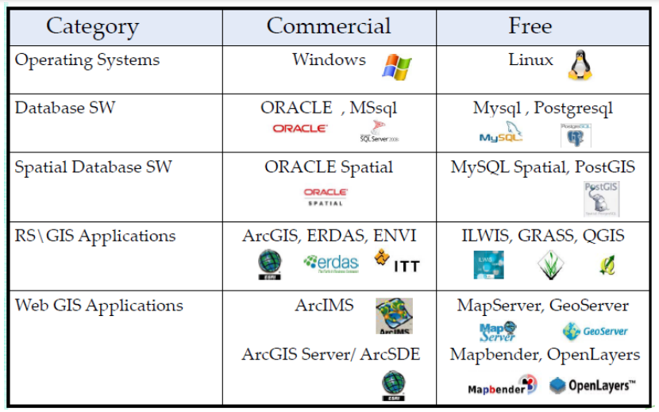
Software

Slide 13
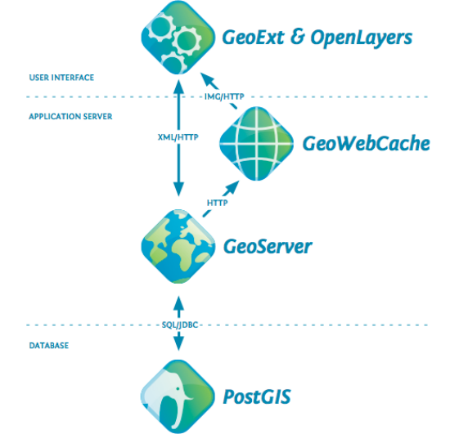
FOSS Architecture (OpenGeo)

Slide 14
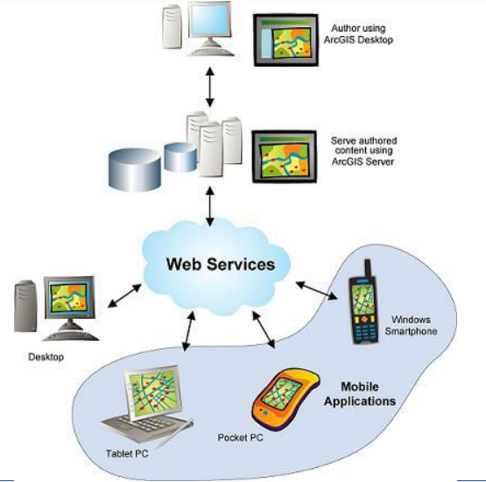
COTS Architecture (Esri ArcGIS)
off-the-shelf (COTS)

Slide 15
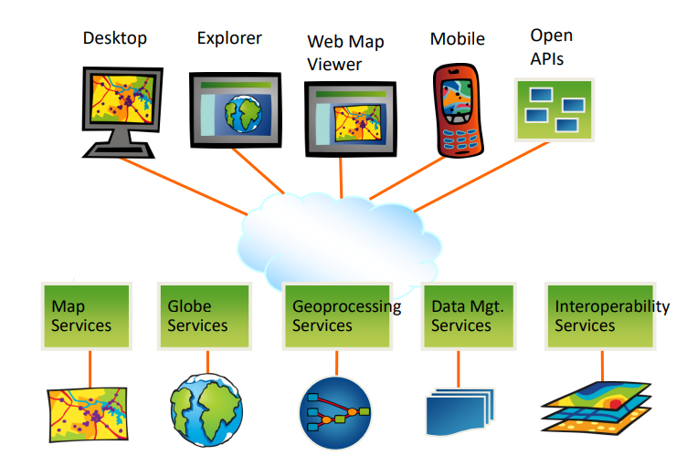
ESRI ArcGIS Web Services

Slide 16
GeoPortals
Derived from the latin word “porta” , indicating a doorway
A webportal is a website that functions as an entry point to the World Wide
Web portals can be classified by their range of content
A GeoPortal, as indicated by the prefix geo, is a portal that specializes in geospatial information
A GeoPortal is a website that provides a single point of access to geospatial data, web services and other geospatially related resources.
GeoPortals are an important and highly visible component of SDI, serving as the “face” of SDI.

Slide 18
Globalization, politics, and GIS

Slide 19
Globalization, politics, and GIS
Global databases
Global partnerships for standards
GIS and Extreme events: SDI and terrorism
GIS contribution in extreme events (Risk assessment, Preparedness, Mitigation, Response, Recovery)

Slide 20
Global databases
Some of the most popular SDIs include:
GeoNetwork
ESRI ArcGIS.
Open Geospatial Consortium (OGC)
INSPIRE
NASA Earth Science Data Systems (ESDS)
These are just a few examples of the many SDIs that are available today.
The choice of SDI will depend on factors such as the type of geospatial data being managed, the needs of the organization, and the available resources.

Slide 21
Global databases from most used SDI (1/3)
There are several Spatial Data Infrastructures (SDIs) that are widely used around the world. Some of the most popular SDIs include:
GeoNetwork: GeoNetwork is an open source SDI that is widely used by government agencies, research institutions, and other organizations around the world. It provides a comprehensive platform for managing and sharing geospatial data and includes features such as a metadata editor, a data catalog, and web mapping services.
ESRI ArcGIS: ESRI ArcGIS is a commercial SDI platform that is widely used by government agencies, private companies, and academic institutions. It includes a range of software tools and applications for managing, analyzing, and visualizing geospatial data, as well as cloud-based services for data sharing and collaboration.

Slide 22
Global databases from most used SDI (2/3)
Open Geospatial Consortium (OGC): The OGC is an international consortium that develops and promotes open standards for geospatial data and services. Their standards, such as Web Map Service (WMS) and Web Feature Service (WFS), are widely used in SDI implementations around the world.
INSPIRE: INSPIRE is a European Union initiative aimed at establishing an SDI framework for Europe. It includes a range of policies, standards, and tools for managing and sharing geospatial data across Europe.

Slide 23
Global databases from most used SDI (3/3)
NASA Earth Science Data Systems (ESDS): The ESDS is an SDI that provides access to a wide range of Earth science data products and services, including satellite imagery, climate data, and atmospheric data. It is widely used by researchers, scientists, and other professionals in the Earth science community.
These are just a few examples of the many SDIs that are available today. The choice of SDI will depend on factors such as the type of geospatial data being managed, the needs of the organization, and the available resources.

Slide 24
Global databases from most used SDI
What other Global databases do you know?

Slide 25
Global partnerships for standards
What are Standards and Why are They Important?
A standard is a documented agreement between provider and consumers, established by consensus, that provides rules, guidelines, or characteristics ensuring materials, products, and services are fit for purpose.
Behind the scenes, standards make everyday life work.
They may establish size or shape or capacity of a product, process, or system.
They can specify performance of products or personnel.
They can also define terms so that there is no misunderstanding among those using the standard.

Slide 26
Global partnerships for standards
Open international standards are voluntary consensus-driven standards published by the standards development organizations (SDOs).
Open standards are developed, approved, and maintained via a collaborative and consensus-driven process and made available to the general public. These standards are aimed at achieving legal, data, semantic and/or technical interoperability.
Open standards offer users the opportunity to have a voice in building and learning about the standards.
Based on international standards, profiles may be established and endorsed by governance bodies to meet the specific needs of their country or organization.
Metadata profiles, such as the INSPIRE dataset and service metadata, is an examples of profiles based on international standards.
Open standards help assure that organizations can more quickly take advantage of new geospatial information sources and new technology tools.
International standards help avoid risk by broadly addressing and managing community requirements for interoperability, access, and use.

Slide 27
The Benefits of Open Geospatial Standards
Geospatial information, technologies, and standards help enable and improve the sharing, integration, and application of geospatial information for decision making.
While national governments can make proactive policy choices to maximize benefits, other jurisdictions and enterprises must align with this policy to achieve mutually optimal outcomes.
A multi-national response to a regional disaster is one example where having clear policy on the sharing of geospatial information is critically important.

Slide 28
Closed standards
Closed standards or specifications carry risks that may pose hidden challenges such as delays and costs of expanding or adapting data and software tools to work with other resources, software, or organizations.
Organizations should be aware of the potential risk to interoperability of closed standards or specifications and consider these risks on balance with the benefits.
Open standards and specifications, on the other hand, help organizations best balance their needs while minimizing business and technology risks.

Slide 29
GIS contribution in extreme events
GIS can play a crucial role in managing and responding to extreme events such as earthquakes, or floods.
By integrating various geospatial data layers, GIS enables emergency managers to identify vulnerable areas, assess risks, and develop effective evacuation plans.
GIS facilitates real-time monitoring of the event's progression and helps coordinate response efforts by providing reliable information to first responders.

Slide 30
GIS contribution in extreme events
GIS contribution in extreme events
Risk assessment
Preparedness
Mitigation
Response
Recovery

Slide 31
GIS contribution in extreme events - Example
A recent example of the value of standards was brought to the surface by the COVID-19 pandemic.
Addresses provide one of the most common and unambiguous ways to identify and locate objects, and assist services
Addresses and address data turned out to be crucial in the fight against COVID-19 because they enabled contact tracing and identification of cluster outbreaks.
Non-standardized addresses significantly hinder the response to COVID-19.

Slide 32
GIS contribution in extreme events - Example
The multi-part International Organization for Standardization (ISO) 19160 Addressing Standard supports a variety of stakeholders so that accurate and reliable address data can be made available.
The different parts of ISO 19160 cover topics such as terminology and a conceptual data model for addressing; good practices for address assignment and maintenance; quality of address data; and international postal addressing (jointly developed with the Universal Postal Union).

Slide 33
GIS contribution in extreme events
It is crucial to acknowledge that the same technology can also be misused by terrorists to inflict harm.
The availability of detailed spatial data can aid in identifying vulnerable targets or planning attacks more strategically.
Since these technologies provide detailed information about critical infrastructures like transportation networks or utilities, they could be exploited to plan attacks or disrupt societal functions.

Slide 34
GIS contribution in extreme events
Consequently, stringent security measures must be implemented during the collection, storage, and dissemination of geospatial data to prevent unauthorized access or use by terrorists.
Additionally, robust cyber defenses should be established to protect GIS databases from hacking attempts that seek to exploit vulnerabilities in this critical infrastructure tool.

Slide 35
Dissemination of geospatial information, Ethical aspects
It is essential to acknowledge that the same technology can also be misused by terrorists to inflict harm.
It is vital for professionals working in this field to prioritize security and ensure robust measures are implemented to prevent misuse.
This includes secure data management protocols, restricted access to sensitive information, and stringent regulations governing its use and dissemination among stakeholders.

Slide 36
Ethical aspects (1/2)
Ethical aspects of GIS data inform the responsible and conscious use of geospatial information.
One key consideration is privacy, as GIS data can often be linked to individuals‘ personal and sensitive information, such as home addresses.
Professionals must ensure that collected data is protected and secured from unauthorized access or misuse.
sensitive information e.g. ?

Slide 37
Ethical aspects (2/2)
Issues related to bias in GIS datasets need to be addressed.
Care should be taken to eliminate any biases in data collection or analysis that could perpetuate inequalities or promote unfair treatment towards specific groups of people.
Transparency is also paramount, as professionals should disclose any potential conflicts of interest, limitations, or uncertainties associated with the accuracy and interpretation of GIS data.
A commitment to ethical practices in relation to GIS data enhances trust among stakeholders and fosters equitable decision-making processes within communities.
E.g. bias ?

